Slide 1


Term 1 Week 8
FINAL Preparation for Source Analysis Test:
America in the 1920s

Slide 2

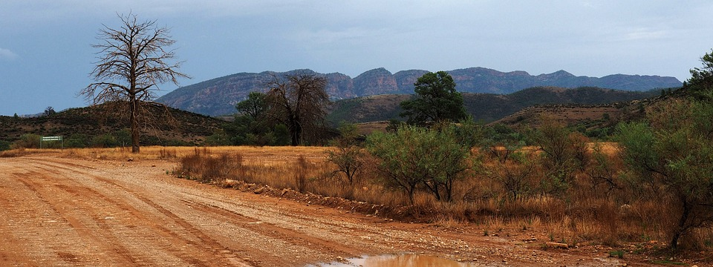


Mike Check Question:
Where would you prefer to spend your holiday?
Outback
Forest
Beach
Mountains

Slide 3


Slide 4
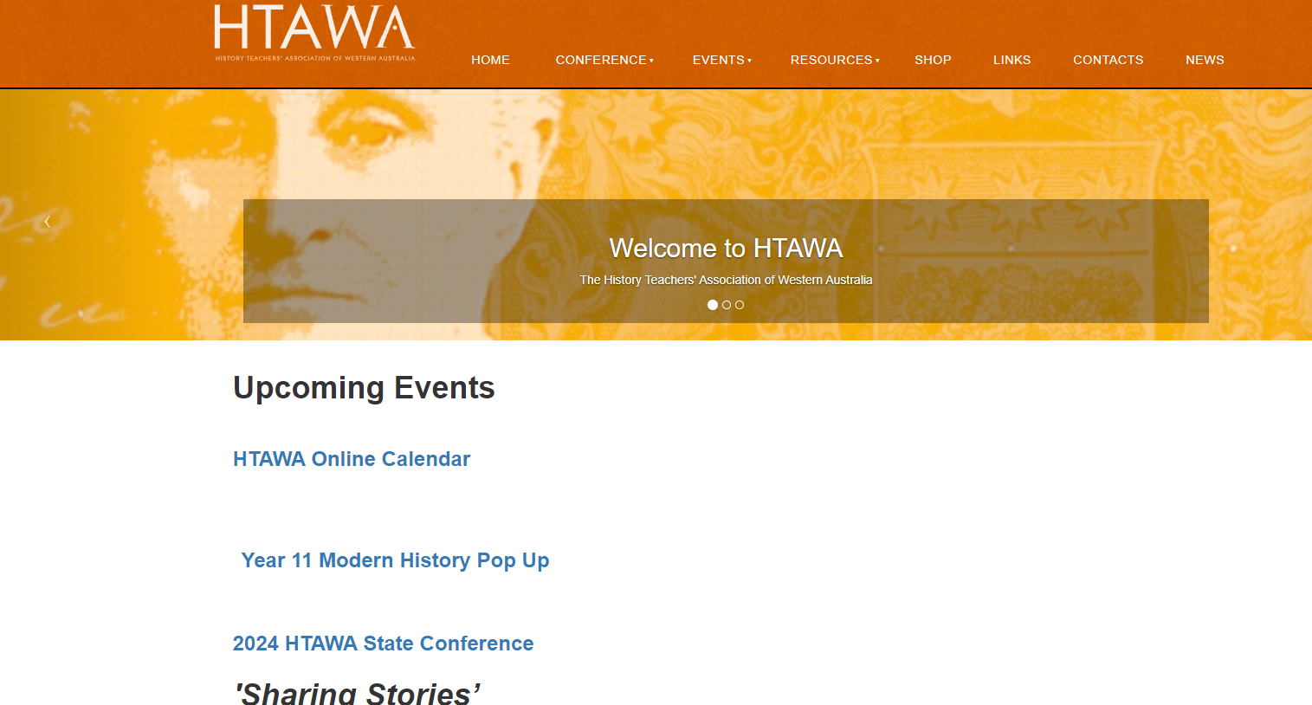


Slide 5
Difference between message and perspective, according to Heather from HTAWA:
Message = what they say
From SCSA: The message of the source refers to what the author is saying, inferring, or trying to tell the reader/viewer of the source. Students can identify the message in a source using the historical skills of interpretation, analysis, and synthesis. It is the product of the interpretation, analysis and / or synthesis of evidence combined with the demonstration of the student’s historical knowledge and understanding of the content of the unit studied.
Perspective = what they think, why they hold that opinion, how they view a certain idea, person.
Example: 2024 State of the Union address by President Joseph Biden.
Democratic or Biden supporter – best State of the Union Speech ever, strong, articulate, passionate, visionary uniting the nation.
Republican or Trump supporter – dark, angry, mad man rant dividing the nation.

Slide 6


Ukrainian
Tak
Slava Ukraini = National salute.
Glory to Ukraine

Slide 7
Today’s Learning Intentions
Students will be able to:
develop an understanding of the social features of American society in the 1920s.
Identify the elements in a source and the questions which may be asked in the Source Analysis Test in Week 8.

Slide 8
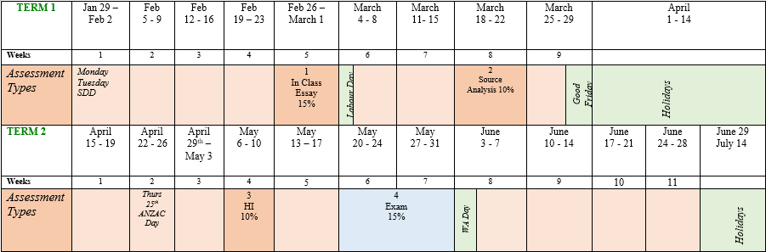
Semester 1: We are here:

Slide 9

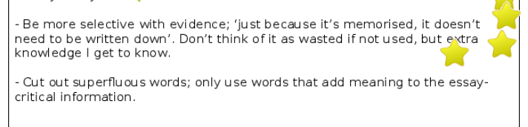
Assessment Task 1: Self-Reflections
These Self-Reflections are due now. Please complete as soon as possible and upload for feedback.
Below is an excellent example of a student who really understood my critical feedback.

Slide 10

Before Google:

Slide 11

Question time:
Do you have any questions to ask me?
Yes ???

Slide 12
Review of Webex Lesson if you miss the lesson: To be sent within seven days of missing the lesson.
What I learnt today:
What went well:
Even better if:
Notes:
Send students off to their white boards to answer ONE of these questions only.

Slide 13


Where are you right now?

Slide 14
FIVE (5) key steps to success in Source Analysis
Know your content knowledge
Understand the intent of each question – that is, what is being asked in each question
Practise analysing sources and acquire a sound general knowledge
Good time management
Planning of all responses

Slide 15
Content which may be covered in the three sources:
the impact on American capitalism of
the 1920s
the growth of consumerism
the nature of American capitalism and the shaping of American values, for example:
film and fashion
prohibition
the ‘Jazz Age’
the Ku Klux Klan
social Darwinism
the American Dream
Remember LACK PANTS

Slide 16
Content which may be covered in the three sources:
the impact of capitalism on different groups within American society
Calvin Coolidge
Helena Rubinstein
Florence Nightingale Graham, aka Elizabeth Arden
the significance of capitalism as an idea in this period

Slide 17
Assessment Task 2: Source Analysis Test – 10% Week 8
Please Note: Your Source Analysis Tests were sent to your Supervisors on Friday afternoon. Please check early in the week to see that they have received them. Not on the morning of the test please.
You will have THREE Sources ONLY based on Book 4.
You will have 50 minutes for the test. 5 minutes reading, 45 minutes writing time.
You will have five questions adding up to 20 marks.

Slide 18
Questions which will be in your test:
(a) Identify the origins of Source 1. (1 mark)
(b) Explain the historical context of Source 1. Include the relevant events, people and ideas depicted or represented in the source. (4 marks)
(c) Compare and contrast the messages of Source 2 and Source 3 relating to ………………………tag of question (4 marks)
(d) Discuss how Source 2 and Source 3 provide useful information for a historian …………………..tag of question (5 marks)
(e) Assess the extent to which Source 1, Source 2 and Source 3 convey the impacts of …….Tag of Question.
This question will be scaffolded for you.

Slide 19
Glossary
Places
People
Other
Events
Terms
LACK PANTS
1925 Butler Act
The Tennessee legislature passed the Butler Act in March 1925. This Act declared unlawful the teaching of any doctrine denying the divine creation of man as taught in the bible.
Scope Trial 1925

Slide 20
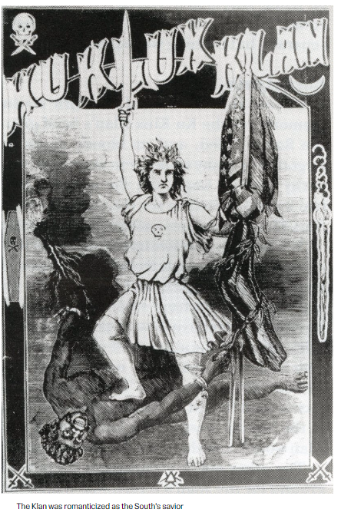
The Birth of a Nation
1915 – viewed in the White House. Increasing intolerance.
Caption: The Klan was romanticised as the saviour of the South.,

Slide 21
KKK: Violence of the Klan in the 1920s.
And its violence was clearly revealed. Under Evans, the Klan launched a campaign of terrorism in the early and mid-1920S, and many communities found themselves firmly in the grasp of the organization. Lynching’s, shootings and whippings were the methods employed by the Klan. Blacks, Jews, Catholics, Mexicans and various immigrants were usually the victims.
But not infrequently, the Klan’s targets were whites, Protestants and females who were considered “immoral” or “traitors” to their race or gender. In Alabama, for example, a divorcee with two children was flogged for the “crime” of remarrying and then given a jar of Vaseline for her wounds. In Georgia, a woman was given 60 lashes for a vague charge of “immorality and failure to go to church”; when her 15-year-old son ran to her rescue, he received the same treatment. In both cases, ministers led the Klansmen responsible for the violence.
But such instances were not confined to the South. In Oklahoma, Klansmen applied the lash to girls caught riding in automobiles with young men, and very early in the Klan revival, women were flogged and even tortured in the San Joaquin Valley of California.
In a period when many women were fighting for the vote, for a place in the job market and for personal and cultural freedom, the Klan claimed to stand for “pure womanhood” and frequently attacked women who sought independence
E
HC
A + O
Ps
Mo
Pp
M
U
KKK: A History of racism: Ku Klux Klan: A History of Racism | Southern Poverty Law Center (splcenter.org) Date Accessed: 10th March 2024

Slide 22
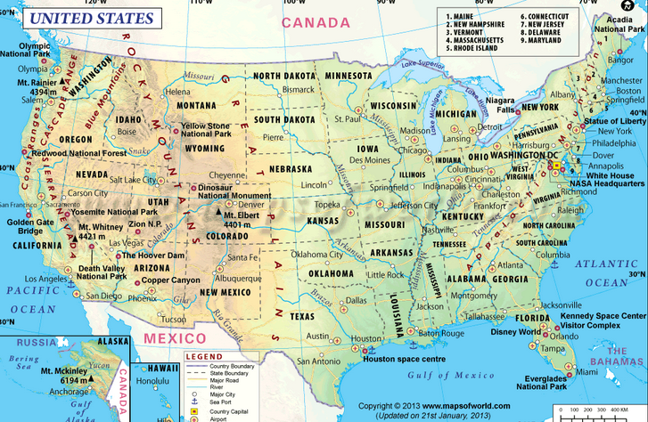
The USA
Notes:
Ask student if they know where the first 13 colonies were located. Asked students if they know the states in the union and confederacy.
Introduce the term Manifest Destiny. Add to Glossary.

Slide 23
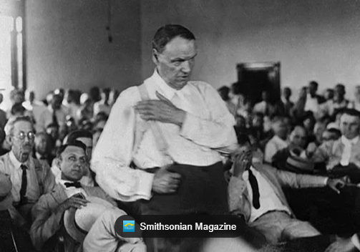
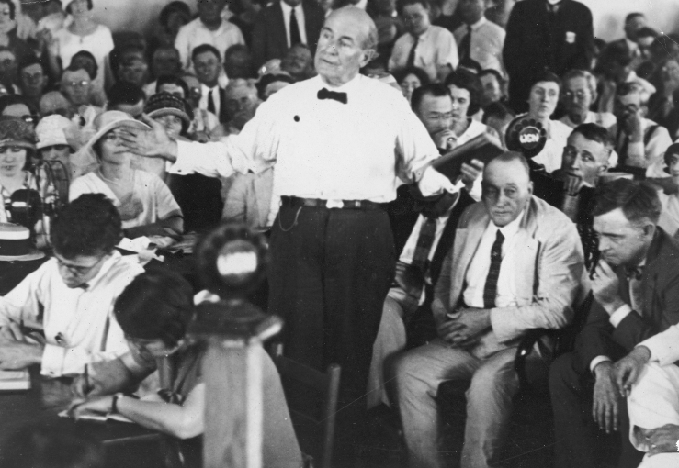
Two lawyers who became famous: Two of the best orators of the era.
Clarence Darrow – defending Science Teacher John Scopes
Lost the case and the law was not repealed until 1967.
William Jennings Bryan – prosecution for the case. Won the case.

Slide 24
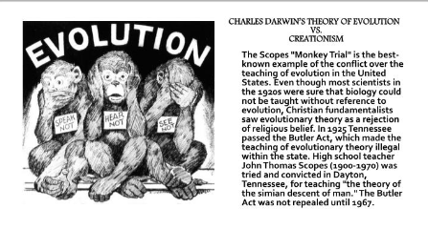
Scopes Trial: Social Darwinism
E
HC
A + O
Ps
Mo
Pp
M
U

Slide 25
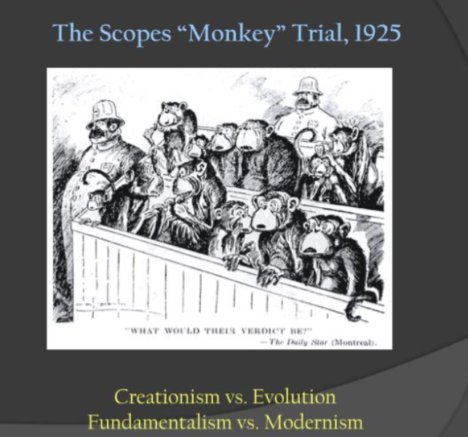
E
HC
A + O
Ps
Mo
Pp
M
U

Slide 26
Play video:
What was life like in the 1920s?

Slide 27
Forces from the syllabus:
Economic
Political
International
Relations
USA 1907 - 1941
Social and Cultural
Leadership
Ideas

Slide 28
Student Voice
What I learnt today:
What went well:
Even better if:
Notes:
Send students off to their white boards to answer ONE of these questions only.

Slide 29


